Slide 1

PRESENTING
SMALL CAP. GIANT POTENTIAL.
BAJAJ FINSERV SMALL CAP FUND
BAJAJ FINSERV ASSET MANAGEMENT LIMITED

Slide 2

WHY INVEST IN
SMALL CAPS NOW?
BAJAJ FINSERV ASSET MANAGEMENT LIMITED

Slide 3


SMALL IN SIZE,
NOT IN IMPACT
EVERYDAY LEADERS ACROSS
INDUSTRIES THAT ARE SMALL CAPS
Consumer durables
Capital goods
Consumer services
FMCG
Metals & Mining
Healthcare
BFSI
Construction materials
Power
Automobile and auto components
And many more..
PLEASE NOTE THAT THE REFERENCE TO ANY INDUSTRY/ SECTOR IS PROVIDED FOR ILLUSTRATIVE PURPOSES ONLY. THIS SHOULD NOT BE CONSTRUED AS A RESEARCH REPORT OR A RECOMMENDATION TO BUY OR SELL ANY SECURITY OR SECTOR.
BAJAJ FINSERV ASSET MANAGEMENT LIMITED
THE SLIDE IS FOR THE PURPOSE OF EXHIBITING SEGMENT LEADERS IN SMALL CAP COMPANIES AND THERE IS NO ASSURANCE OR GUARANTEE THAT THESE STOCKS WILL BE PART OF THE FUND’S PORTFOLIO.

Slide 4
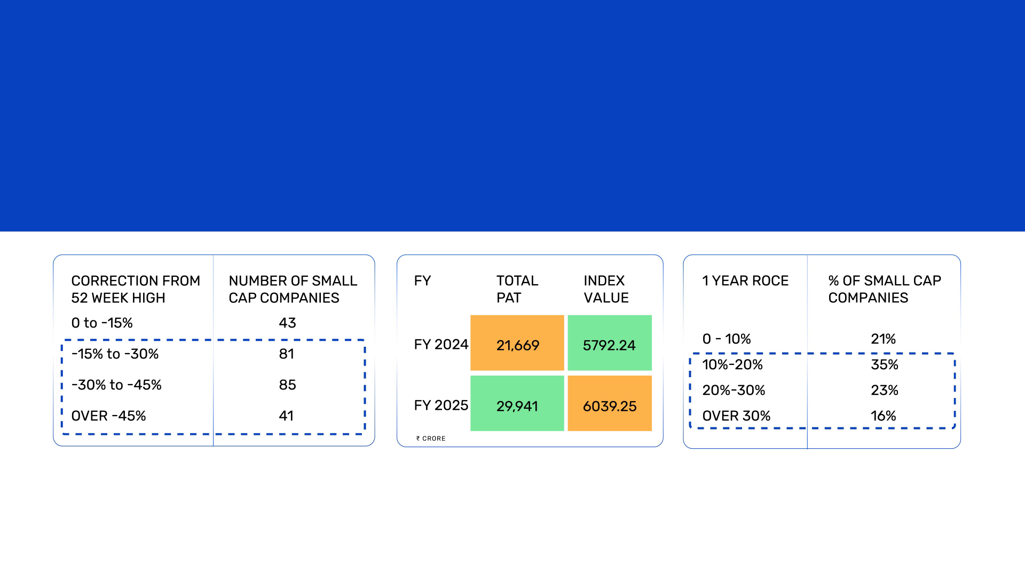
CORRECTION IN PRICE, NOT IN QUALITY
FY25 SAW A CORRECTION IN SMALL CAPS, OFFERING AN OPPORTUNITY TO BUY QUALITY AT DISCOUNT.
ROCE: RETURN ON
CAPITAL EMPLOYED
Most are trading well below 52-week highs,
making valuations compelling.
The index rose just 4% since FY24 while PAT grew 38%, reflecting the unrealized value of small caps.
74% of the top 250 small caps report ROCE above 10%, reflecting strong fundamentals.
BAJAJ FINSERV ASSET MANAGEMENT LIMITED
SOURCE: ACE EQUITY
COMPANIES CONSIDERED HERE ARE THE TOP 250 SMALL CAP COMPANIES | DATA AS ON APRIL 30, 2025
*INDEX VALUES CONSIDERED FOR BSE 250 SMALLCAP INDEX | DATA FOR FY 2024 IS AS ON MAR 31, 2024, FOR FY 2025 IS AS ON MAR 31, 2025

Slide 5
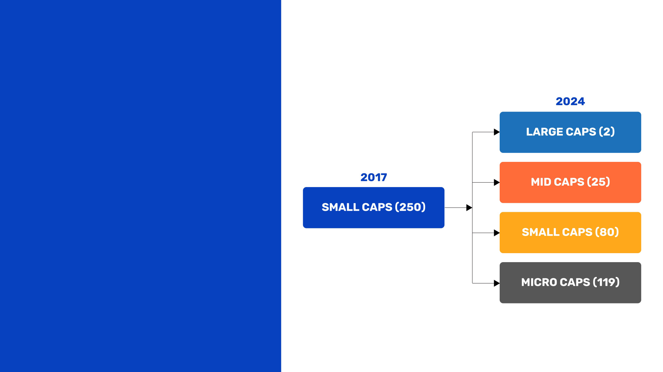
NOT ALL SMALL CAPS GROW TO BECOME LARGE CAPS
Nearly 50% of the small cap companies from 2017 have slipped into micro cap territory. This highlighs the importance of not just picking the right small caps, but also knowing what to avoid.
BAJAJ FINSERV ASSET MANAGEMENT LIMITED
SOURCE: CATEGORY CLASSIFICATION AS PER AMFI EXCEPT FOR MICRO CAP | DATA AS ON DEC 31 2024. MICRO CAPS ARE COMPANIES BEYOND THE TOP 500 LISTED COMPANIES BY MARKET CAP

Slide 6

BAJAJ FINSERV ASSET MANAGEMENT LIMITED

Slide 7

5 PILLARS OF OUR APPROACH
QUALITY
GROWTH
UNDERVALUED
OPPORTUNITIES
LEADERSHIP
GOVERNANCE
Sound fundamentals
Consistent earnings
Sustainable competitive advantages
Long-term vision
Long growth runway
Sustainable business models
Stocks trading below their intrinsic values
Strong fundamentals but temporary mispricing
Turnaround businesses
Emerging category leaders
Dominant in niche segments
High market share in
micro segments
Transparent practices
Aligned promoter interests
Run by seasoned managements
BAJAJ FINSERV ASSET MANAGEMENT LIMITED

Slide 8

RISK-PRUDENT, NOT RISK-AVERSE
Fund’s approach to mitigating risks and unlocking growth in small caps
RISK
HOW IT AFFECTS INVESTORS
FUND’S RISK MITIGATION APPROACH
Information Gaps
Low analyst coverage, limited disclosures, poor transparency
In-depth internal research, management interaction, and forensic checks
Governance Concerns
Promoter dominance, related-party transactions, ethical lapses
Strict governance filters, promoter background checks
Capital Misallocation
Reckless expansion, unrelated diversification, poor ROE projects
Emphasis on capital efficiency and strong ROCE/ROE track record
High Leverage
Excessive debt makes companies vulnerable in downturns
Prefer companies with healthy balance sheet and interest coverage ratios
Business Concentration
Over-dependence on a single product, client, or geography
of the business
Screen for robust revenue models and de-risk by diversified growth
ROCE: RETURN ON CAPITAL EMPLOYED | ROE: RETURN ON EQUITY
BAJAJ FINSERV ASSET MANAGEMENT LIMITED

Slide 9
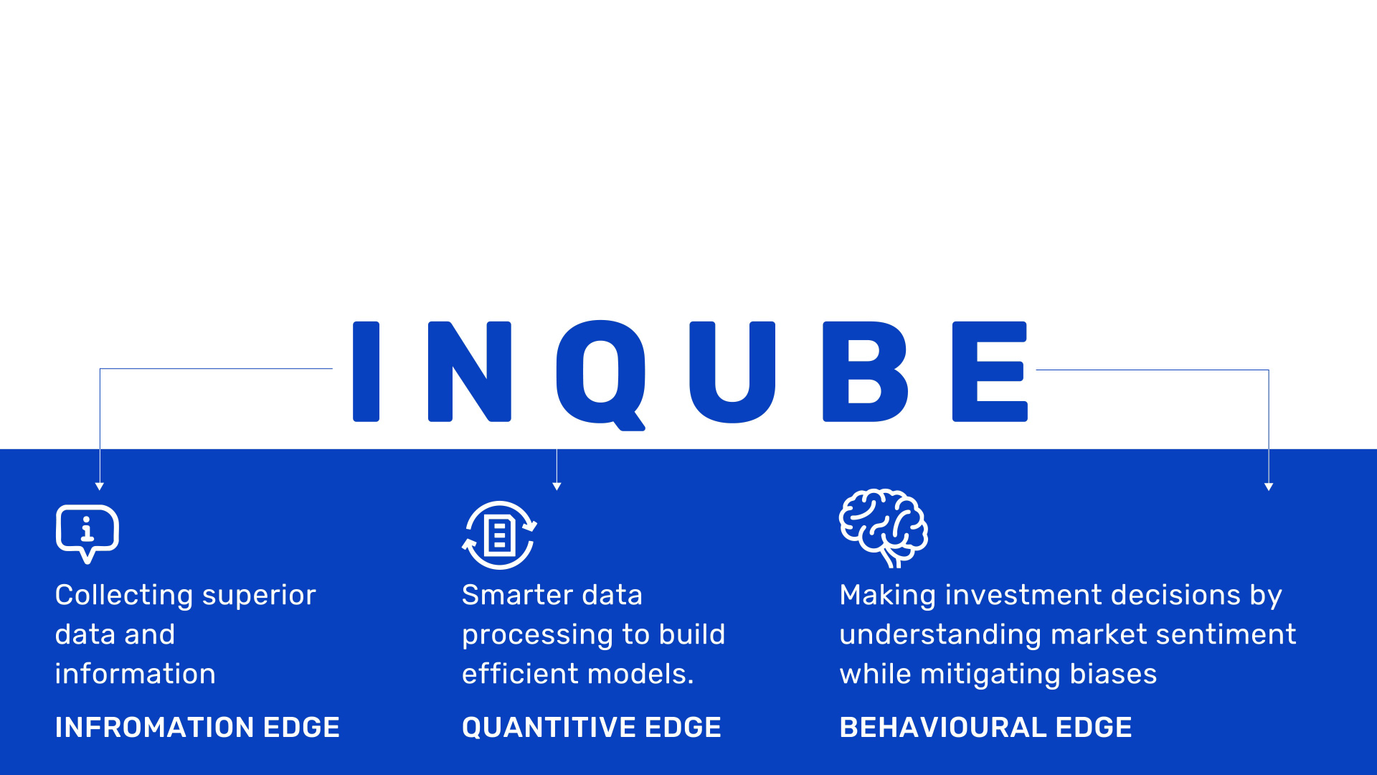
THE INVESTMENT PHILOSOPHY THAT GENERATES LONG-TERM OUTPERFORMANCE - INQUBE
While most investors focus on what to invest in, we focus on how to invest more effectively. To achieve this, we've identified three key sources of alpha with a holistic approach that blends fundamental analysis, quantitative modeling, and behavioural insights.
BAJAJ FINSERV ASSET MANAGEMENT LIMITED

Slide 10

EQUITY INVESTMENT PROCESS
IDENTIFYING
ANALYSING
ALLOCATION
IDENTIFYING CYCLES
AND MEGATRENDS
INVESTMENT CHECKLIST
Macros
Cycles
Themes
Trends
Market indicators
Business
Management
Valuation
Regulatory requirements
Internal risk management limits
Investment mandate
Investment recording
Position sizing
Screener
Corporate meetings
In-house research
External analysts/Consultants
BAJAJ FINSERV ASSET MANAGEMENT LIMITED

Slide 11
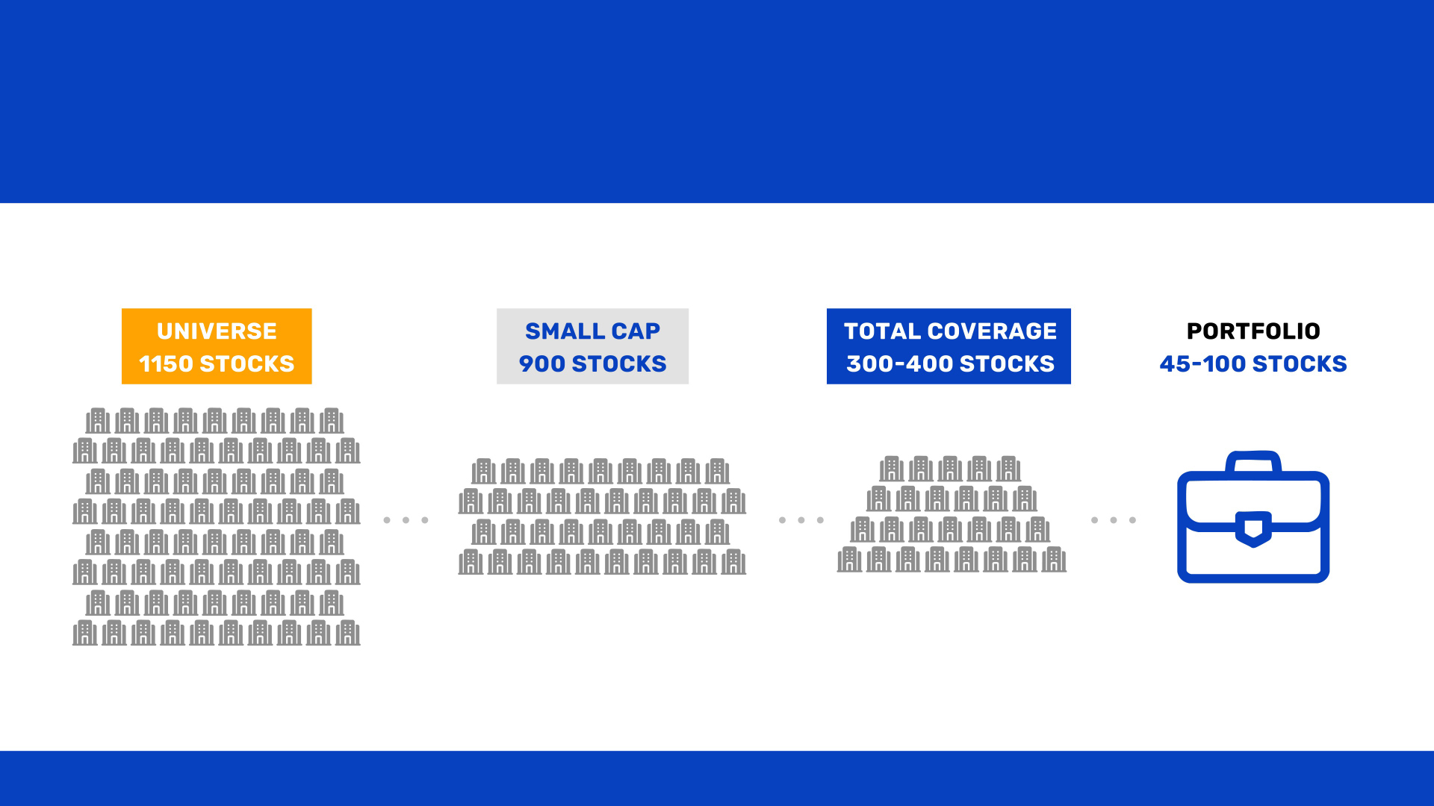
PORTFOLIO CREATION PROCESS
BAJAJ FINSERV ASSET MANAGEMENT LIMITED

Slide 12

EQUITY INVESTMENT PROCESS
POST-INVESTMENT REVIEW
MONITOR INVESTMENT PERFORMANCE
Track the performance of investments over time
Regularly evaluate business performance and market trends
Monitor key financial and non-financial metrics
RE-EVALUATE EXIT STRATEGY
Determine exit points based on evolving market conditions to generate alpha
Adjust strategies based on updated information
BAJAJ FINSERV ASSET MANAGEMENT LIMITED

Slide 13
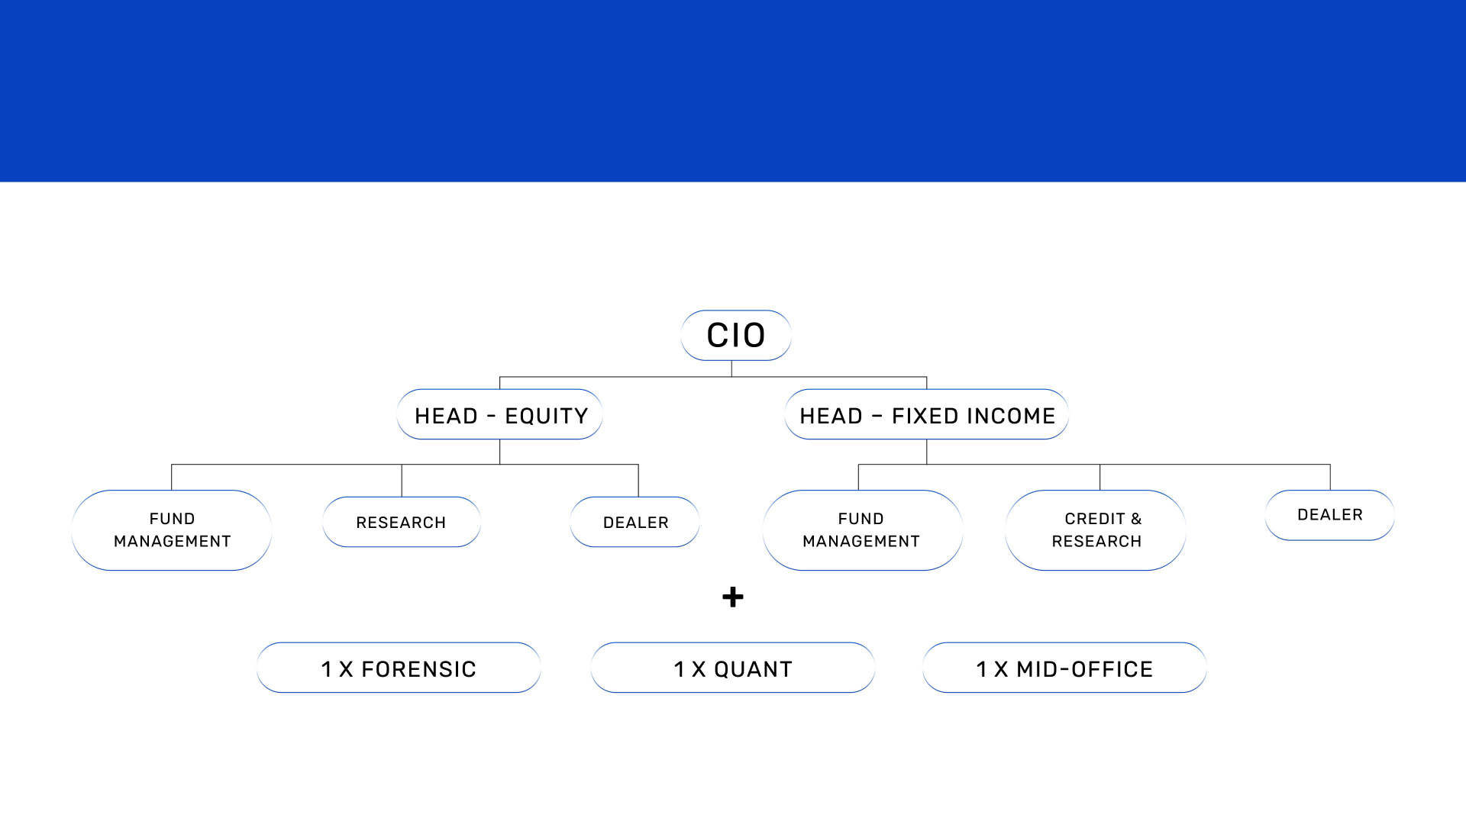
SEASONED TEAM WITH MULTI-DOMAIN EXPERTISE
27-MEMBER TEAM WITH A COMBINED EXPERIENCE OF 267 YEARS. 19 MBAS, 6 CFAS, 3 CAS, 1 MA (ECO)
BAJAJ FINSERV ASSET MANAGEMENT LIMITED

Slide 14
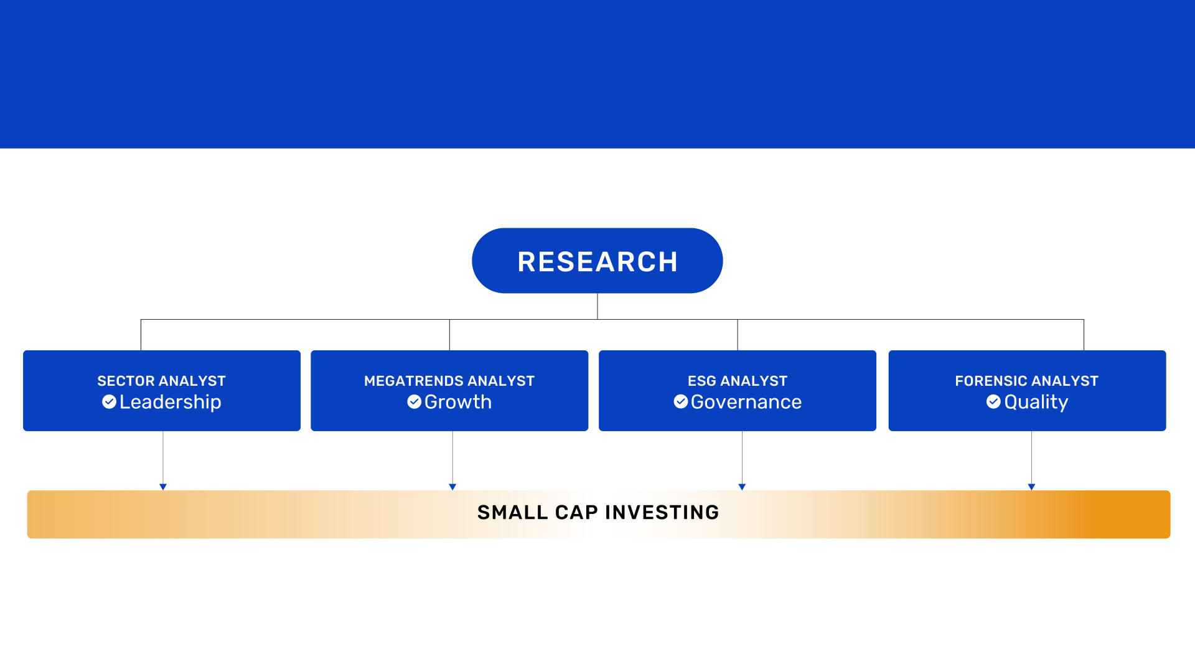
SEASONED TEAM WITH MULTI-DOMAIN EXPERTISE
BAJAJ FINSERV ASSET MANAGEMENT LIMITED

Slide 15

ENSURING QUALITY IN SMALL CAP INVESTING
Forensic Research Process
STEPS
FOCUS AREA
KEY CHECKS/INDICATORS
Initial Screening
Forensic risk model, red flag triggers
Unusual profit growth, auditor changes, high pledging, sudden equity dilution
Accounting Quality
Earnings credibility & revenue recognition
Cash flow vs. profit mismatch, aggressive revenue booking, capex vs. asset productivity
Cash Flow & Balance Sheet
Earnings credibility & revenue recognition
CFO vs. PAT, rising receivables/inventory,
high leverage, poor interest coverage
Promoter & Governance
Promoter intent, board practices, historical conduct
Promoter pledging, litigation history, related-party transactions, board independence – independent directors, board autonomy ensuring proper checks and balances
Auditor & Disclosure Check
Auditor quality, reportiang transparency
Frequent auditor change, qualified audit opinions, delayed financials, inadequate disclosures
Red Flag Mapping & Scoring
Risk assessment & investment decision support
Forensic scorecard, watchlist maintenance
BAJAJ FINSERV ASSET MANAGEMENT LIMITED

Slide 16

WHO IS THIS FUND FOR?
INVESTORS WHO:
Want to invest in fundamentally strong businesses in the small cap space trading below intrinsic value.
Prefer quality small cap businesses with robust governance and long-term sustainability.
Want to diversify their portfolio adding small caps with high growth potential.
Are looking to build wealth by capturing small cap growth over time.
BAJAJ FINSERV ASSET MANAGEMENT LIMITED

Slide 17
PORTFOLIO
Stock | Market Value as % of Net Asset (Eq)
Schaeffler India Limited | 3.63%
Timken India Limited | 3.63%
Navin Fluorine International Limited | 3.49%
Rubicon Research Limited | 3.34%
The Federal Bank Limited | 3.33%
Ujjivan Small Finance Bank Limited | 2.83%
Angel One Limited | 2.73%
S.J.S. Enterprises Limited | 2.69%
Neuland Laboratories Limited | 2.65%
HEG Limited | 2.31%
Welspun Corp Limited | 2.15%
K.P.R. Mill Limited | 2.06%
CreditAccess Grameen Limited | 2.03%
Sobha Limited | 1.94%
Whirlpool of India Limited | 1.88%
Schneider Electric Infrastructure Limited | 1.85%
Ingersoll Rand (India) Limited | 1.85%
PVR INOX Limited | 1.83%
Manappuram Finance Limited | 1.77%
Amber Enterprises India Limited | 1.77%
Zydus Wellness Limited | 1.71%
KNR Constructions Limited | 1.65%
Thangamayil Jewellery Limited | 1.60%
Tega Industries Limited | 1.51%
Sanofi Consumer Healthcare India Limited | 1.49%
Steel Authority of India Limited | 1.46%
Aditya Birla Real Estate Limited | 1.42%
Devyani International Limited | 1.41%
TD Power Systems Limited | 1.41%
Stock | Market Value as % of Net Asset (Eq)
RHI Magnesita India Limited | 1.40%
VA Tech Wabag Limited | 1.38%
Brigade Enterprises Limited | 1.34%
Kalpataru Projects International Limited | 1.30%
Piramal Pharma Limited | 1.28%
Safari Industries (India) Limited | 1.27%
RBL Bank Limited | 1.24%
ACC Limited | 1.23%
ZF Commercial Vehicle Control Systems India Limited | 1.00%
Ahluwalia Contracts (India) Limited | 1.00%
Elecon Engineering Company Limited | 0.98%
Apar Industries Limited | 0.89%
Century Plyboards (India) Limited | 0.87%
Dalmia Bharat Limited | 0.85%
Prudent Corporate Advisory Services Limited | 0.84%
Metro Brands Limited | 0.82%
JK Lakshmi Cement Limited | 0.80%
Voltamp Transformers Limited | 0.79%
V-Mart Retail Limited | 0.76%
Emami Limited | 0.76%
Kajaria Ceramics Limited | 0.74%
Time Technoplast Limited | 0.68%
Orient Electric Limited | 0.68%
Niva Bupa Health Insurance Company Limited | 0.67%
Ather Energy Limited | 0.59%
La Opala RG Limited | 0.59%
Garware Technical Fibres Limited | 0.59%
Awfis Space Solutions Limited | 0.58%
EPL Limited | 0.57%
Dixon Technologies (India) Limited | 0.57%
Stock | Market Value as % of Net Asset (Eq)
Grindwell Norton Limited | 0.55%
Arvind Fashions Limited | 0.54%
Nesco Limited | 0.53%
Aditya Infotech Limited | 0.50%
Nitin Spinners Limited | 0.44%
Urban Company Ltd. | 0.43%
CCL Products (India) Limited | 0.43%
Neogen Chemicals Limited | 0.43%
Vardhman Textiles Limited | 0.40%
Go Digit General Insurance Limited | 0.37%
AIA Engineering Limited | 0.34%
KEI Industries Limited | 0.34%
Black Buck Ltd | 0.34%
Westlife Foodworld Limited | 0.30%
JSW Holdings Limited | 0.15%
Vedant Fashions Limited | 0.15%
The Ramco Cements Limited | 0.14%
NIFTY | 0.05%
Total Option Equity | 96.91%
Total Short Term Debt and Net Current Assets | 3.09%
Grand Total | 100%
BAJAJ FINSERV ASSET MANAGEMENT LIMITED
Data as on 31st March 2026

Slide 18
Portfolio Allocation
BAJAJ FINSERV ASSET MANAGEMENT LIMITED
Data as on 31st March 2026

Slide 19
Sector Allocation
BAJAJ FINSERV ASSET MANAGEMENT LIMITED
Data as on 31st March 2026

Slide 20
Scheme Features
Scheme Type | An open-ended equity scheme investing predominantly in small caps
Plans | Regular| Direct
Option | Growth| IDCW
Minimum Application Amount | Rs. 500 (Plus, multiples of Re.1)
Minimum Additional Application | Rs. 100 (Plus, multiples of Re.1)
Entry Load | Not Applicable
Exit Load | If units are redeemed switched out : Within 6 months from the date of allotment- if 10% of units held- Nil ,if rest 90% are held then 1% of the applicable NAV More than 6 months from the date of allotment – Nil
Fund Manager | Equity portion – Mr. Nimesh Chandan & Mr. Sorbh Gupta Debt Portion: Mr. Siddharth Chaudhary
Benchmark Index | BSE 250 Small cap TRI
SIP/ SWP/ STP | Available
NAV in Rs. | Regular: 8.3950 Direct: 8.4880
AUM in Rs Cr. | 1,530.05cr.
TER | Regular: 2.05 Direct: 0.55
BAJAJ FINSERV ASSET MANAGEMENT LIMITED

Slide 21
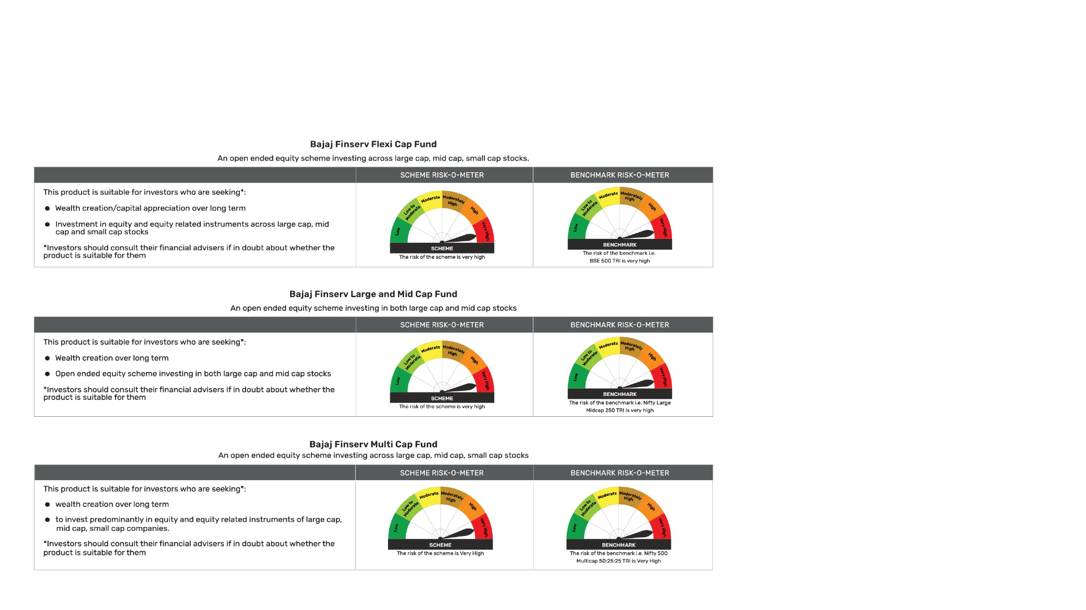
RISK-O-METER AND PRODUCT LABEL.
BAJAJ FINSERV ASSET MANAGEMENT LIMITED

Slide 22
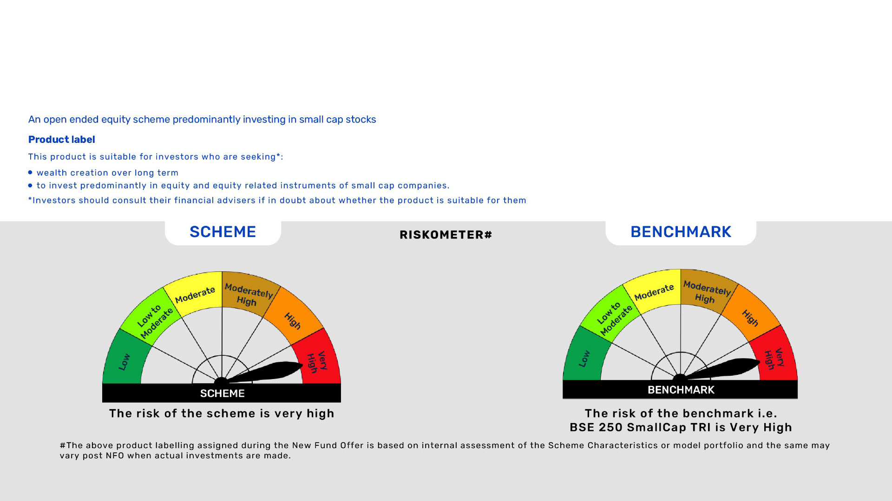
BAJAJ FINSERV SMALL CAP FUND
BAJAJ FINSERV ASSET MANAGEMENT LIMITED

Slide 23
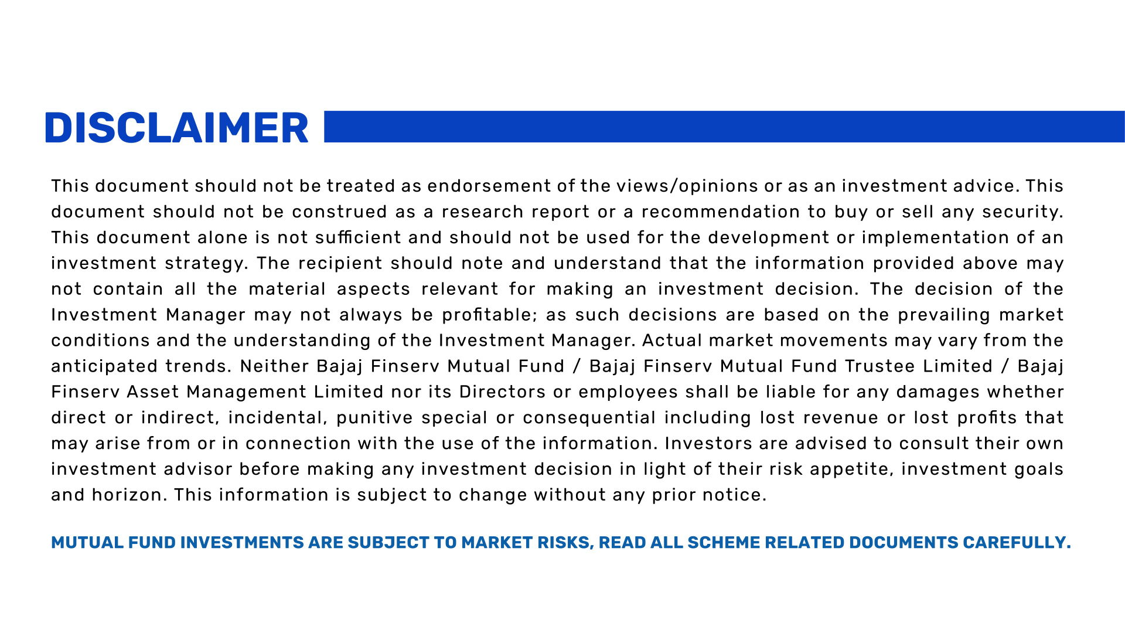
BAJAJ FINSERV ASSET MANAGEMENT LIMITED

