Slide 1



Bajaj Finserv Nifty Bank ETF An open ended exchange traded fund tracking Nifty Bank Index
April 2026

Slide 2
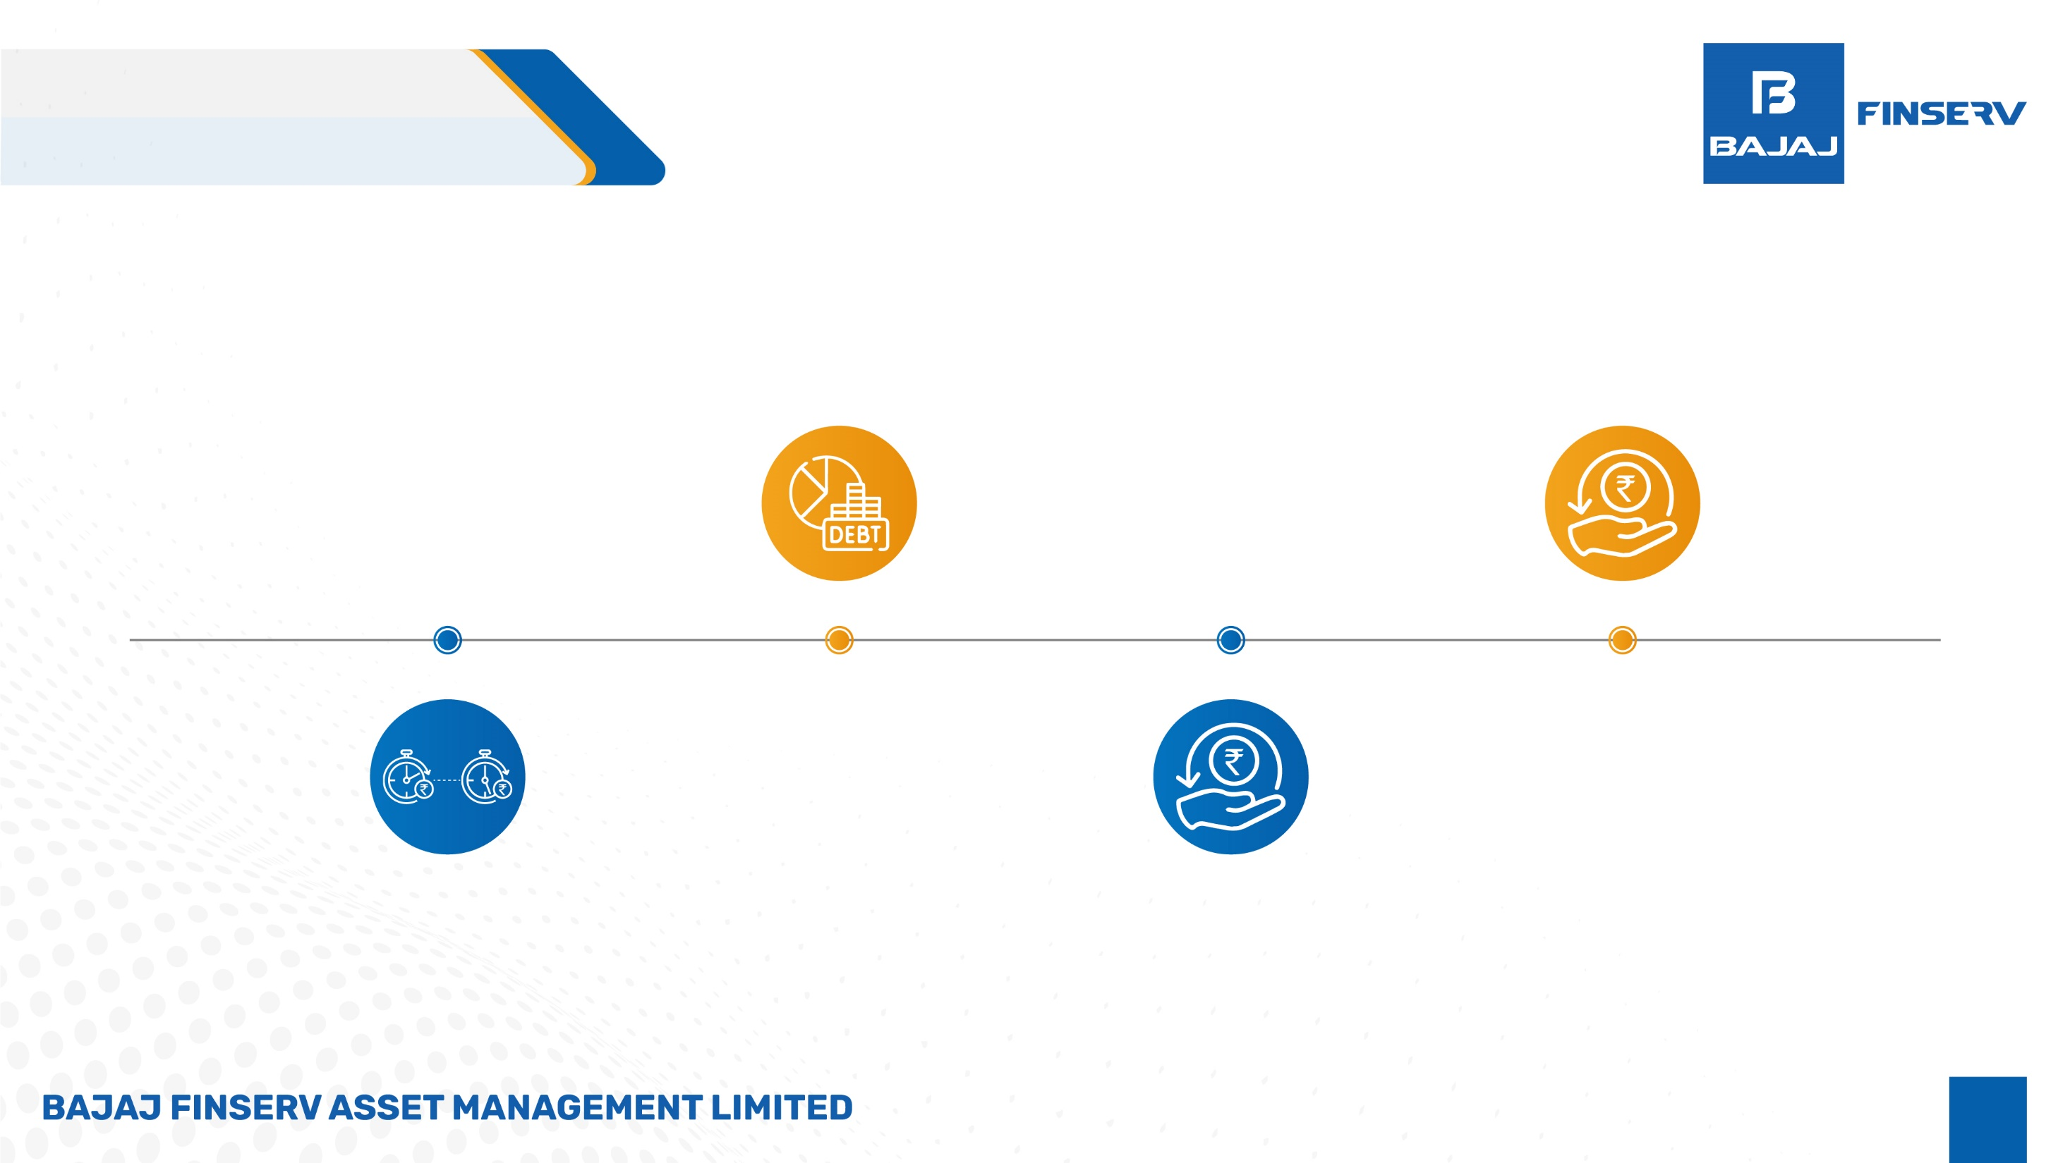

What are ETFs?
1
Broad Market Exposure
An ETF, or Exchange-Traded Fund, is like a basket of different investments that you can buy on the stock exchange. like buying a portion of many companies or assets all at once.
3
Simple
This lets you invest in a diversiﬁed basket of securities in a easy way without needing to buy each investment separately.
2
Consistent Strategy
Aims to replicate market returns of the Index, reducing the impact of short-term market ﬂuctuations subject to tracking error.
4
Lower Fees
ETFs generally have lower management fees compared to actively managed funds.

Slide 3
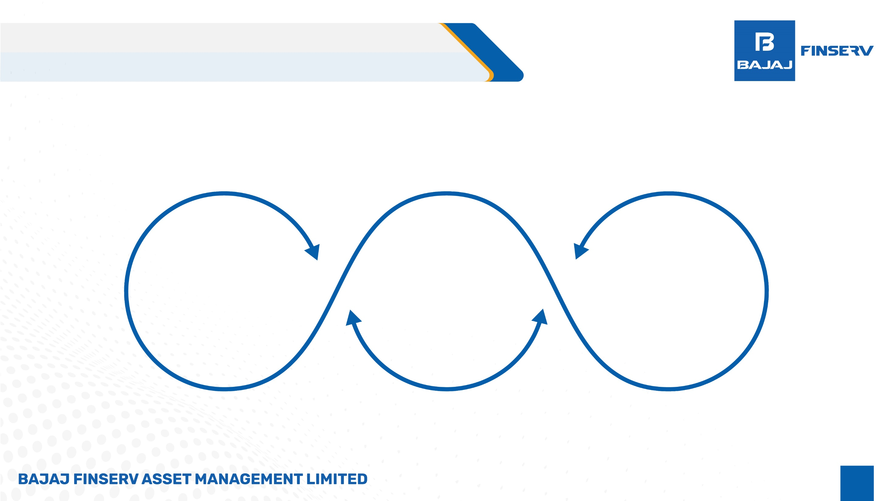
ETFs: Ideal combination of Mutual Funds & Stocks
Similar to Mutual Funds
An ETF comprises a portfolio of stocks or bonds which is managed by professionals.
ETFs:
Efficient, Transparent, and Diversiﬁed Investment option
Similar to a Stock An ETF is tradable during regular market hours, allowing for buying and selling at any time.

Slide 4
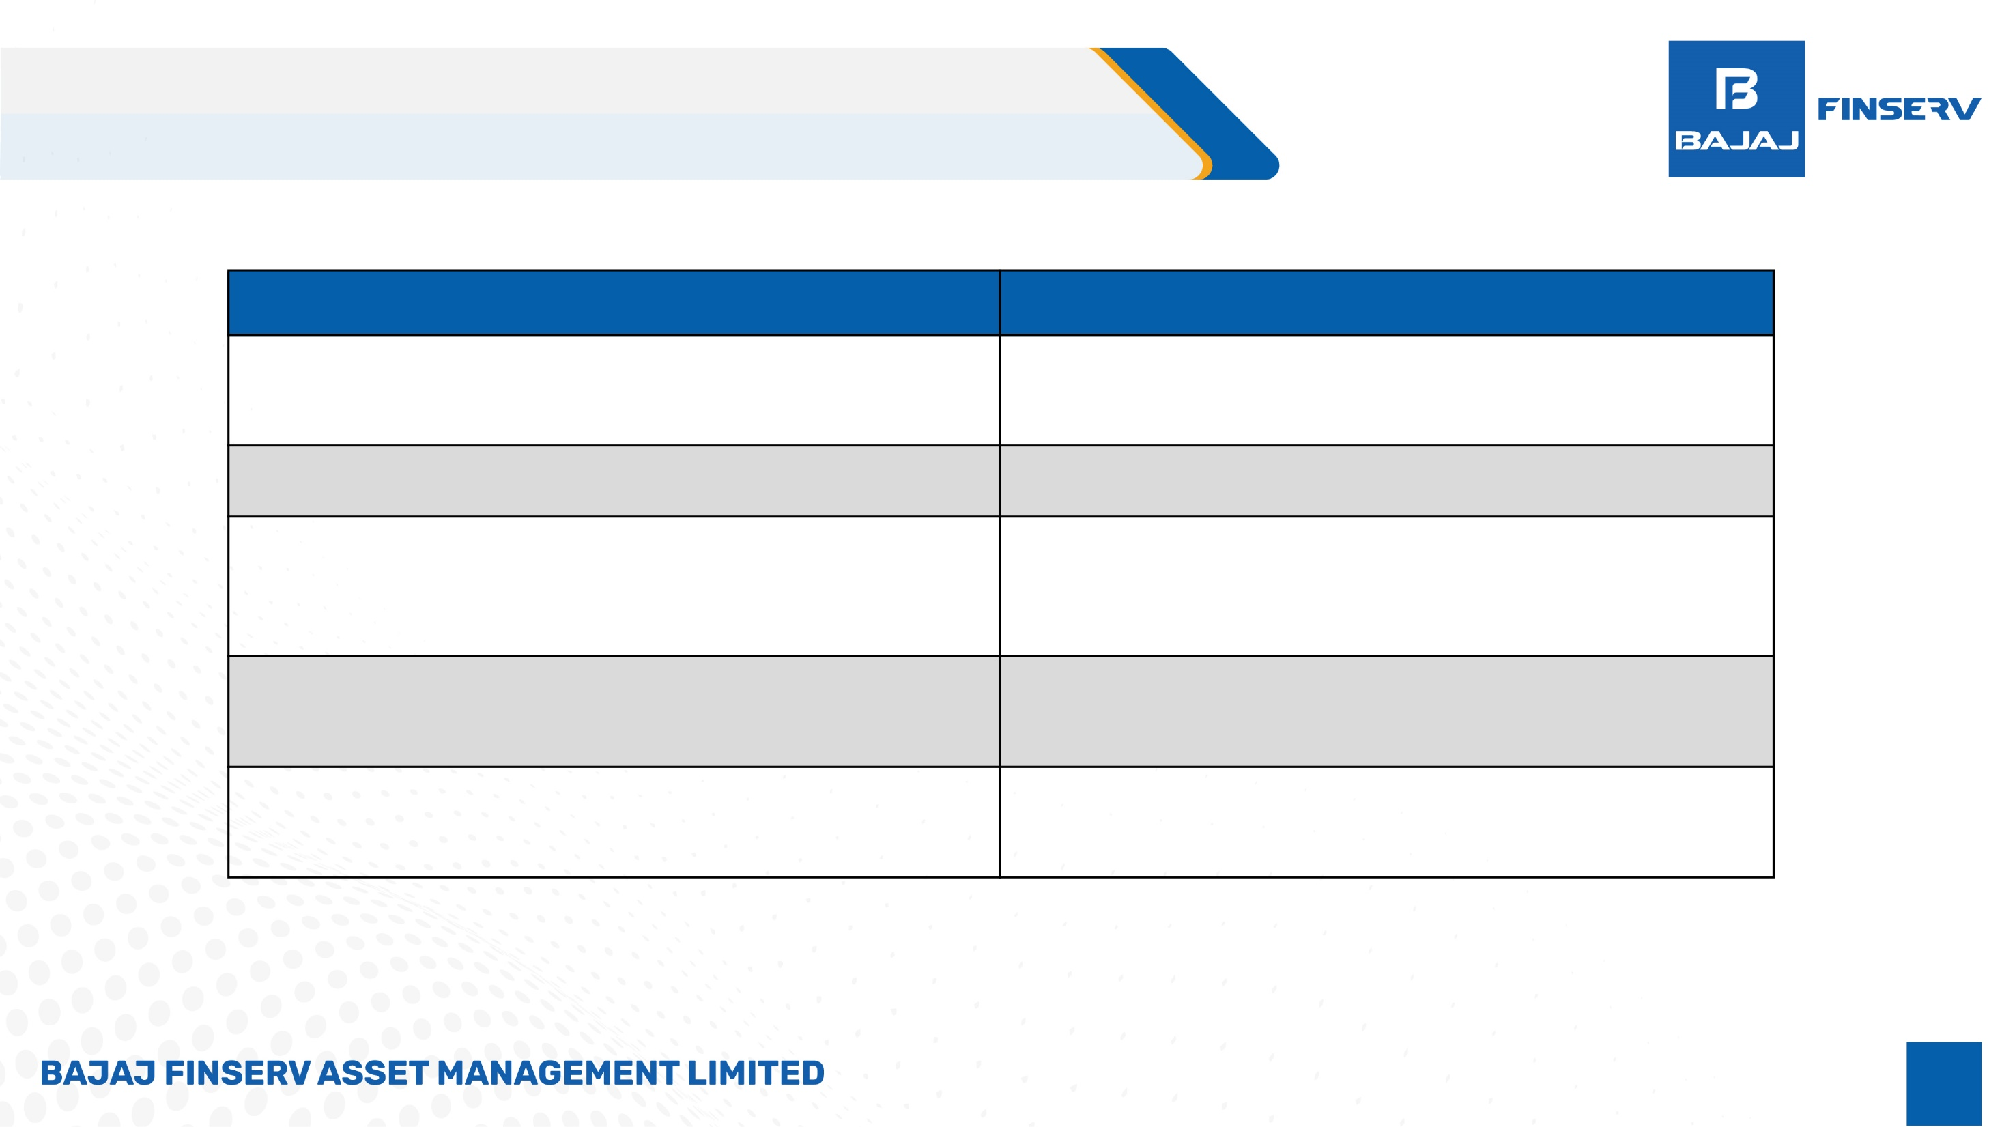
ETFs: Difference between ETF & Active Fund
ETF
ETF NAV gets updated real time during the Market timings.
A Demat account is required for transactions.
You have the ﬂexibility to purchase or sell units at any time, from any location, and with no restrictions on the frequency of transactions.
You can execute buy or sell orders directly with the broker.
ETFs are more cost-effective because of their lower
expense ratio.
Active Funds
You can determine the market value only at the close of
the day.
No Demat account is needed for transactions.
Transactions for buying or selling units are limited to once a day, speciﬁcally after the market closes.
You can execute buy or sell orders directly with AMC or
through distributors.
Active Funds generally have higher expense ratio compared to ETFs

Slide 5
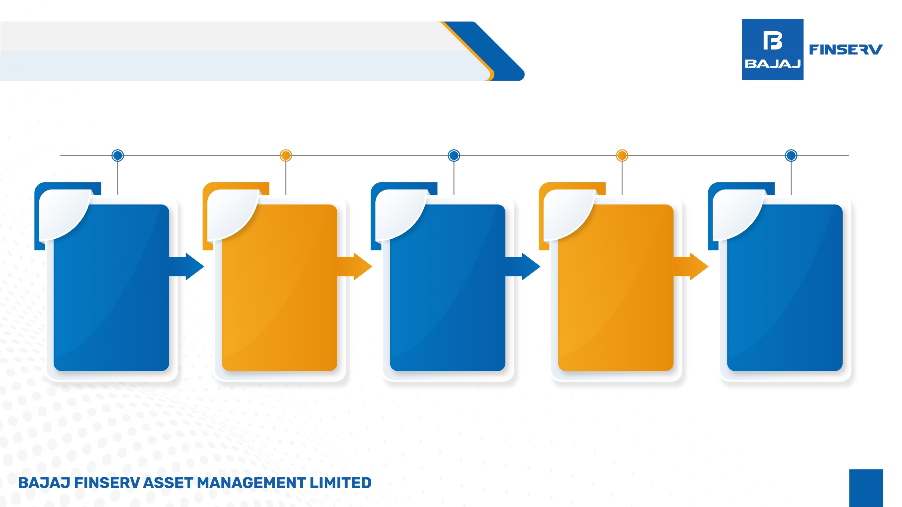
Beneﬁts of Investing in ETFs
1
2
Simplicity: It's straightforward and doesn't
require constant
monitoring and
intervention
3
4
5
Consistent
Strategy: Aims to replicate market returns of the Index, reducing the impact of short-term market ﬂuctuations subject to tracking error.
Lower Fees: Passive funds generally
have lower management fees compared to actively
managed funds.
Broad Market Exposure:
ETFs track market indexes, providing instant diversiﬁcation across many
assets.
Long-Term
Focus: Suited for investors looking for steady,
long-term growth
potential of
equities without frequent adjustments.

Slide 6
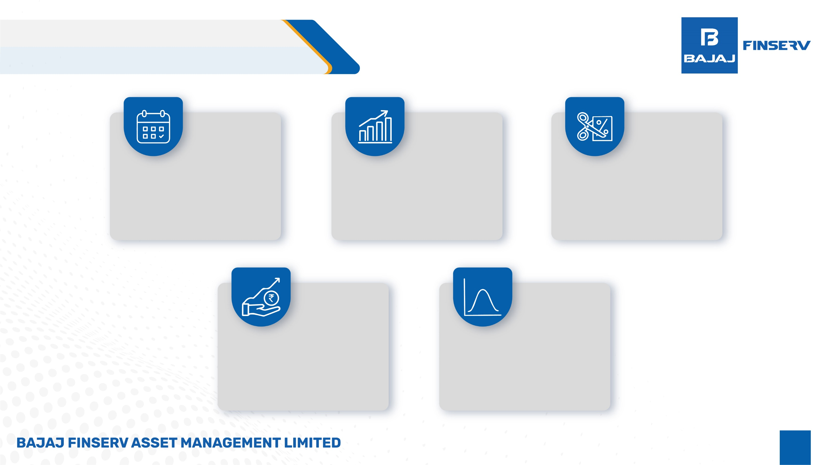

Key Drivers of ETF AUM growth:
The Employees Provident Funds Organization (EPFO) and other retirement trusts are required to invest in equities through ETFs.
The Bharat Bond ETF series is introduced to raise long-term debt capital through ETFs.
Central Public Sector Enterprise (CPSE) Bonds are issued through Issuer Driven ETFs.
Innovative Products: Introduction of innovative ETF products catering to speciﬁc themes or sectors has captured investor interest and driven growth.
Passive Investing Trend: The global trend towards passive investing has inﬂuenced Indian investors to consider ETFs, especially those tracking benchmark indices.

Slide 7
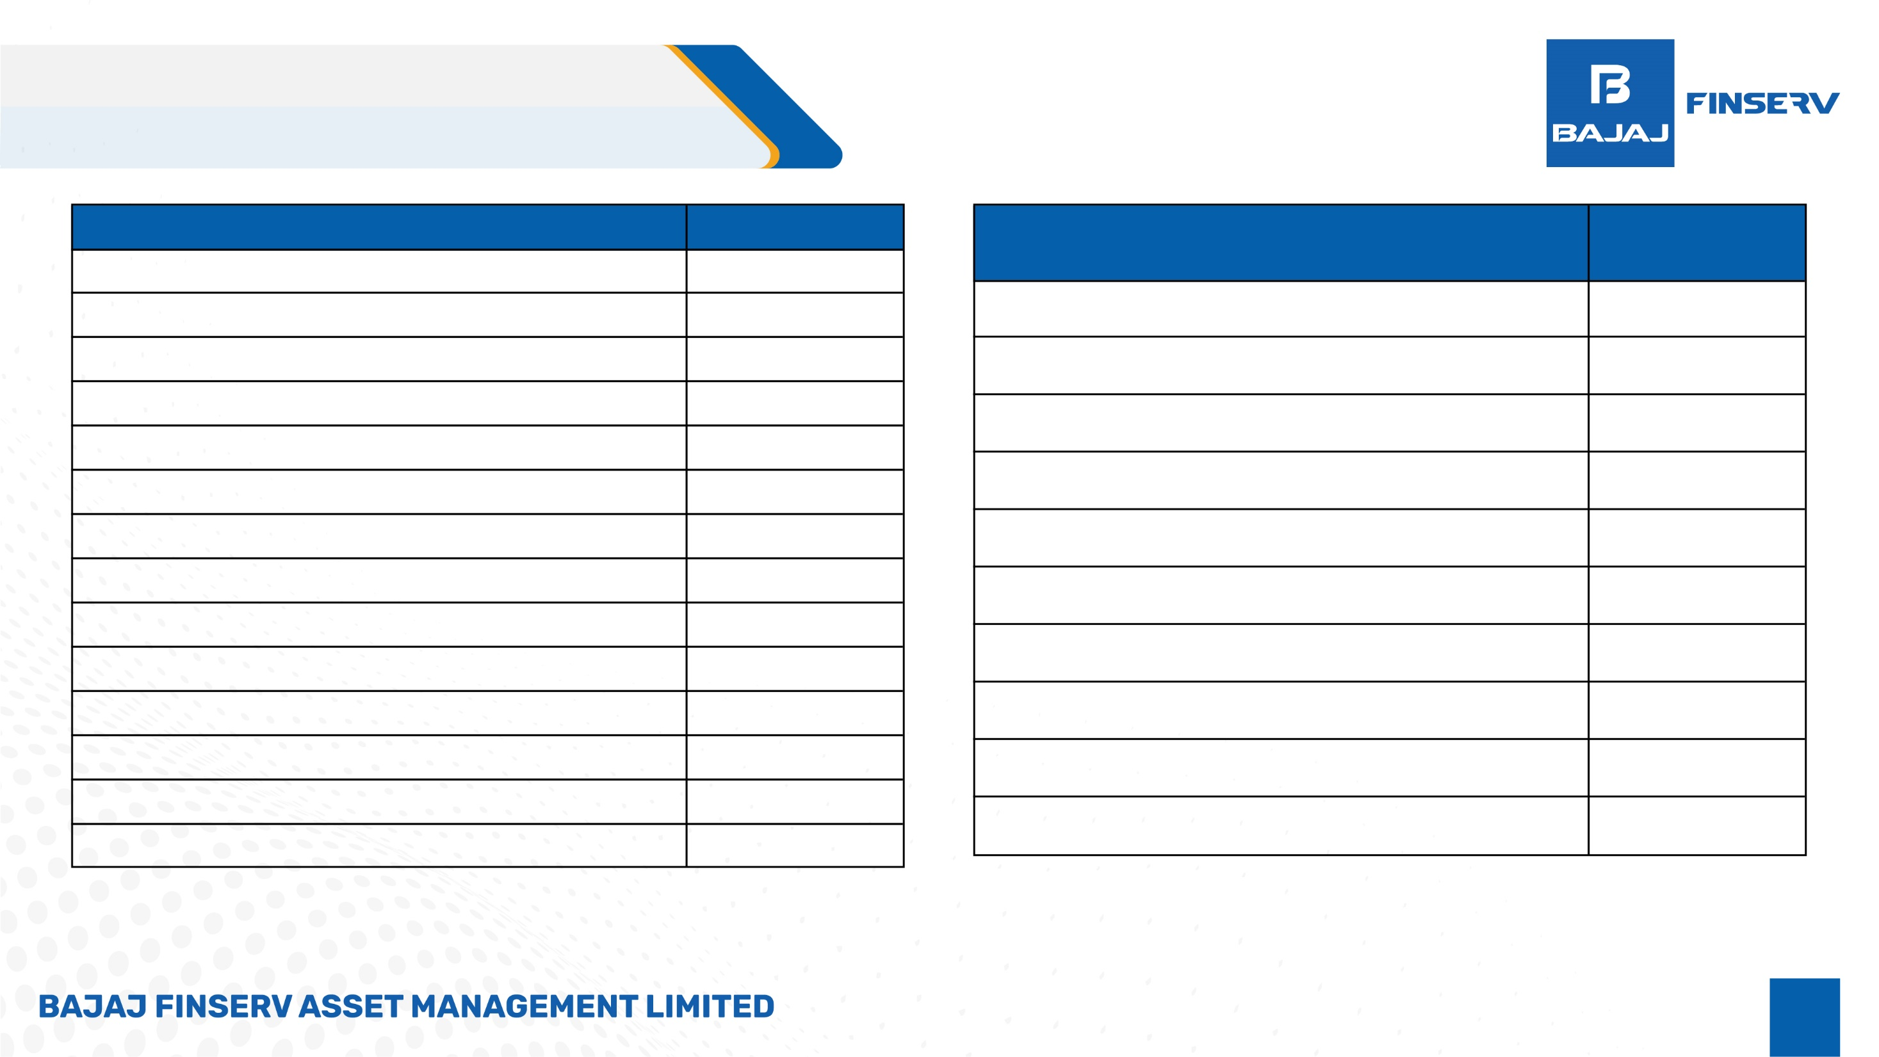

Why to invest in Banking Sector
Stability: India's banking sector offers stability, attracting investors for consistent returns.
Middle Class Growth: The expanding middle class boosts demand for banking services, fostering growth.
Government Support: Initiatives like financial inclusion and digital banking support sector expansion.
Tech Integration: Increasing adoption of technology enhances operational efficiency and customer engagement.
Regulatory Confidence: Stringent regulations ensure transparency, reducing the risk of major financial crises.
Diversified Services: Banks offer a range of services beyond traditional banking, broadening investment opportunities.
Credit Growth: Economic expansion drives demand for credit, benefiting banks' lending activities.
Global Presence: Indian banks expanding globally enhance competitiveness on an international scale.

Slide 8
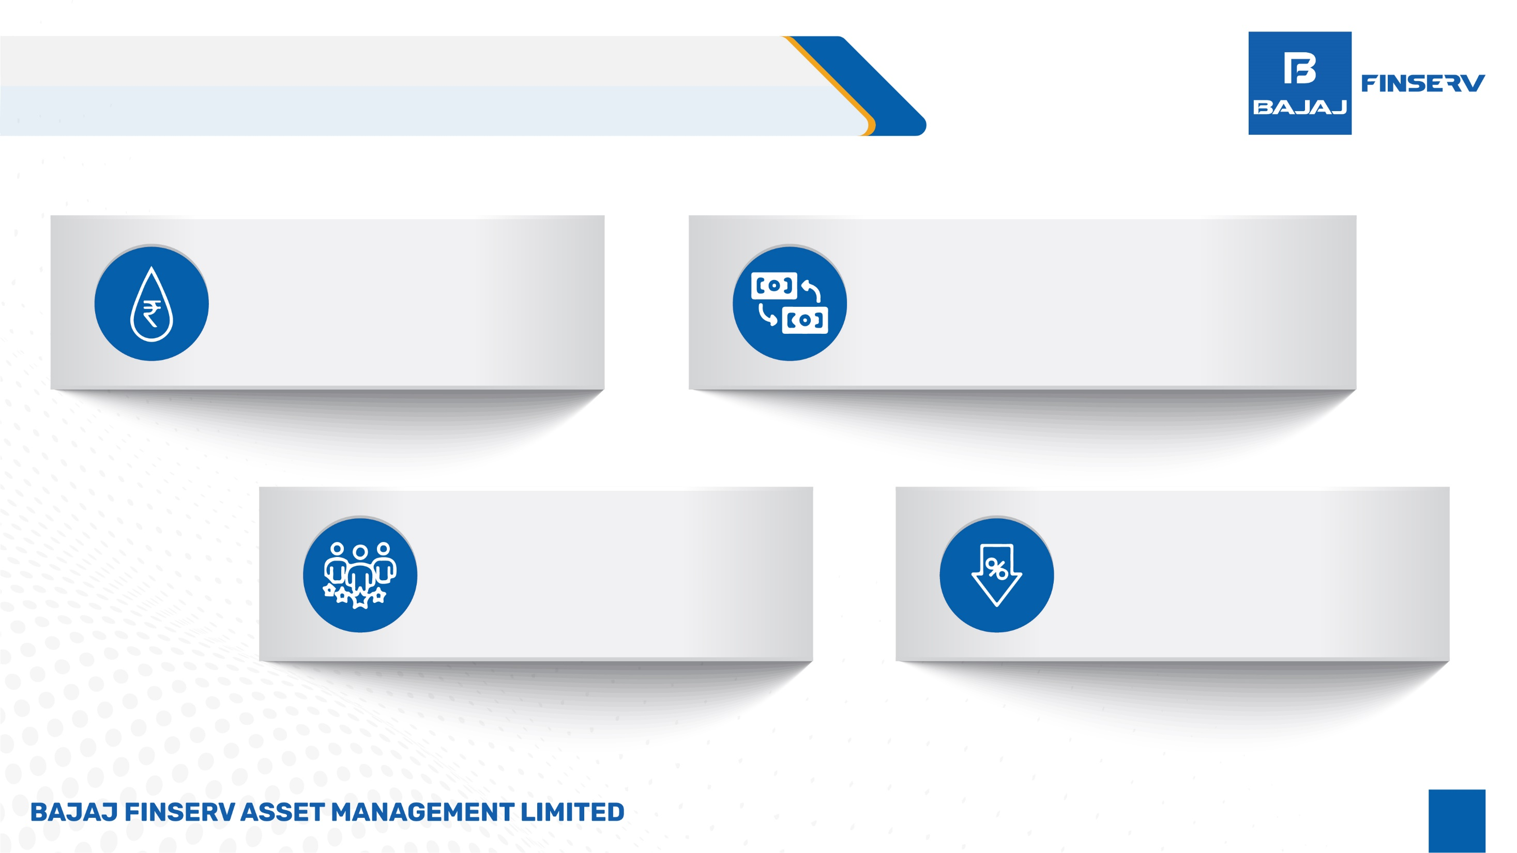
Bajaj Finserv Nifty Bank ETF Advantages
Offering liquidity
Supplied by the Authorized Participant (AP) on the exchange at all times, closely tracking the latest real-time Net Asset Value (NAV) or indicative NAV (iNAV)
Lower spread on exchange
A reduced effective spread, factoring in Securities Transaction Tax (STT) and brokerage. For substantial orders, the Authorized Participant (AP) can provide quotes at a negotiable price, with an effective spread of approximately 0 basis points.
Our Market Makers
East India Securities Limited
Kanjalochana Finserv Pvt Ltd
Parwati Capital Market Private Limited
Relatively Low cost
To trade in Bajaj Finserv Nifty Bank ETF
vis-à-vis active funds

Slide 9
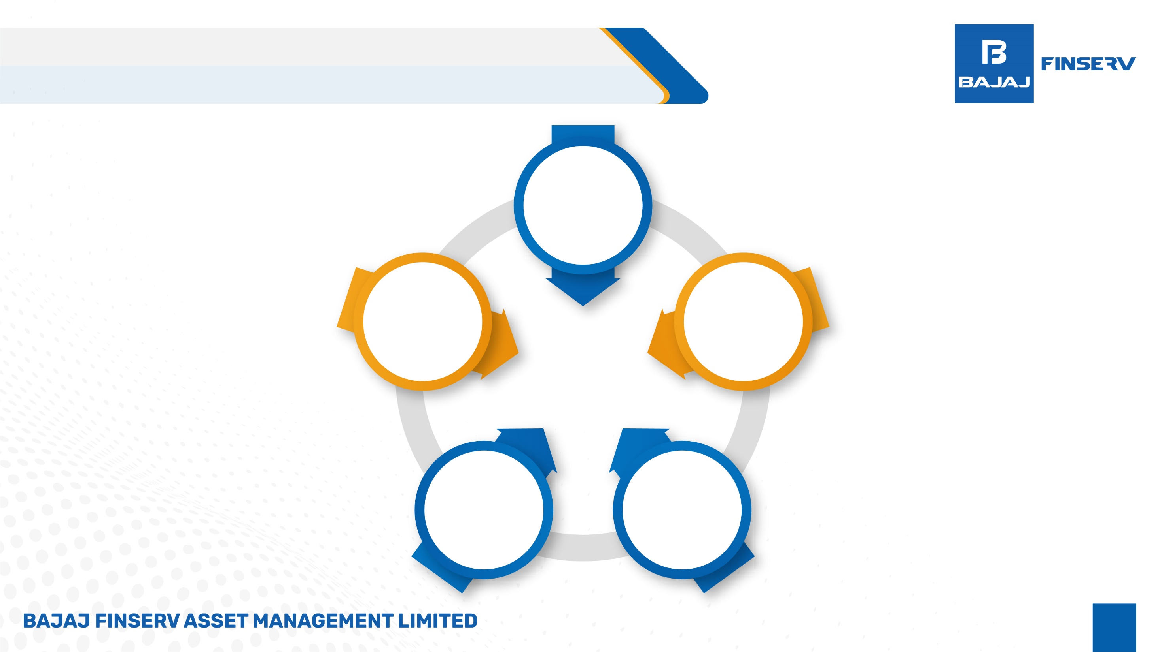
Advantage of Bajaj Finserv Nifty Bank ETF
market makers
Aim to keep Low Bid-Ask Spread
Advance Algorithmic tools will be used to reduce tracking error
Striving to keep No additional spread by market maker
Substantial orders can be
effortlessly fulﬁlled
at a singular price without any additional spread
Aim to Lower Impact Cost

Slide 10
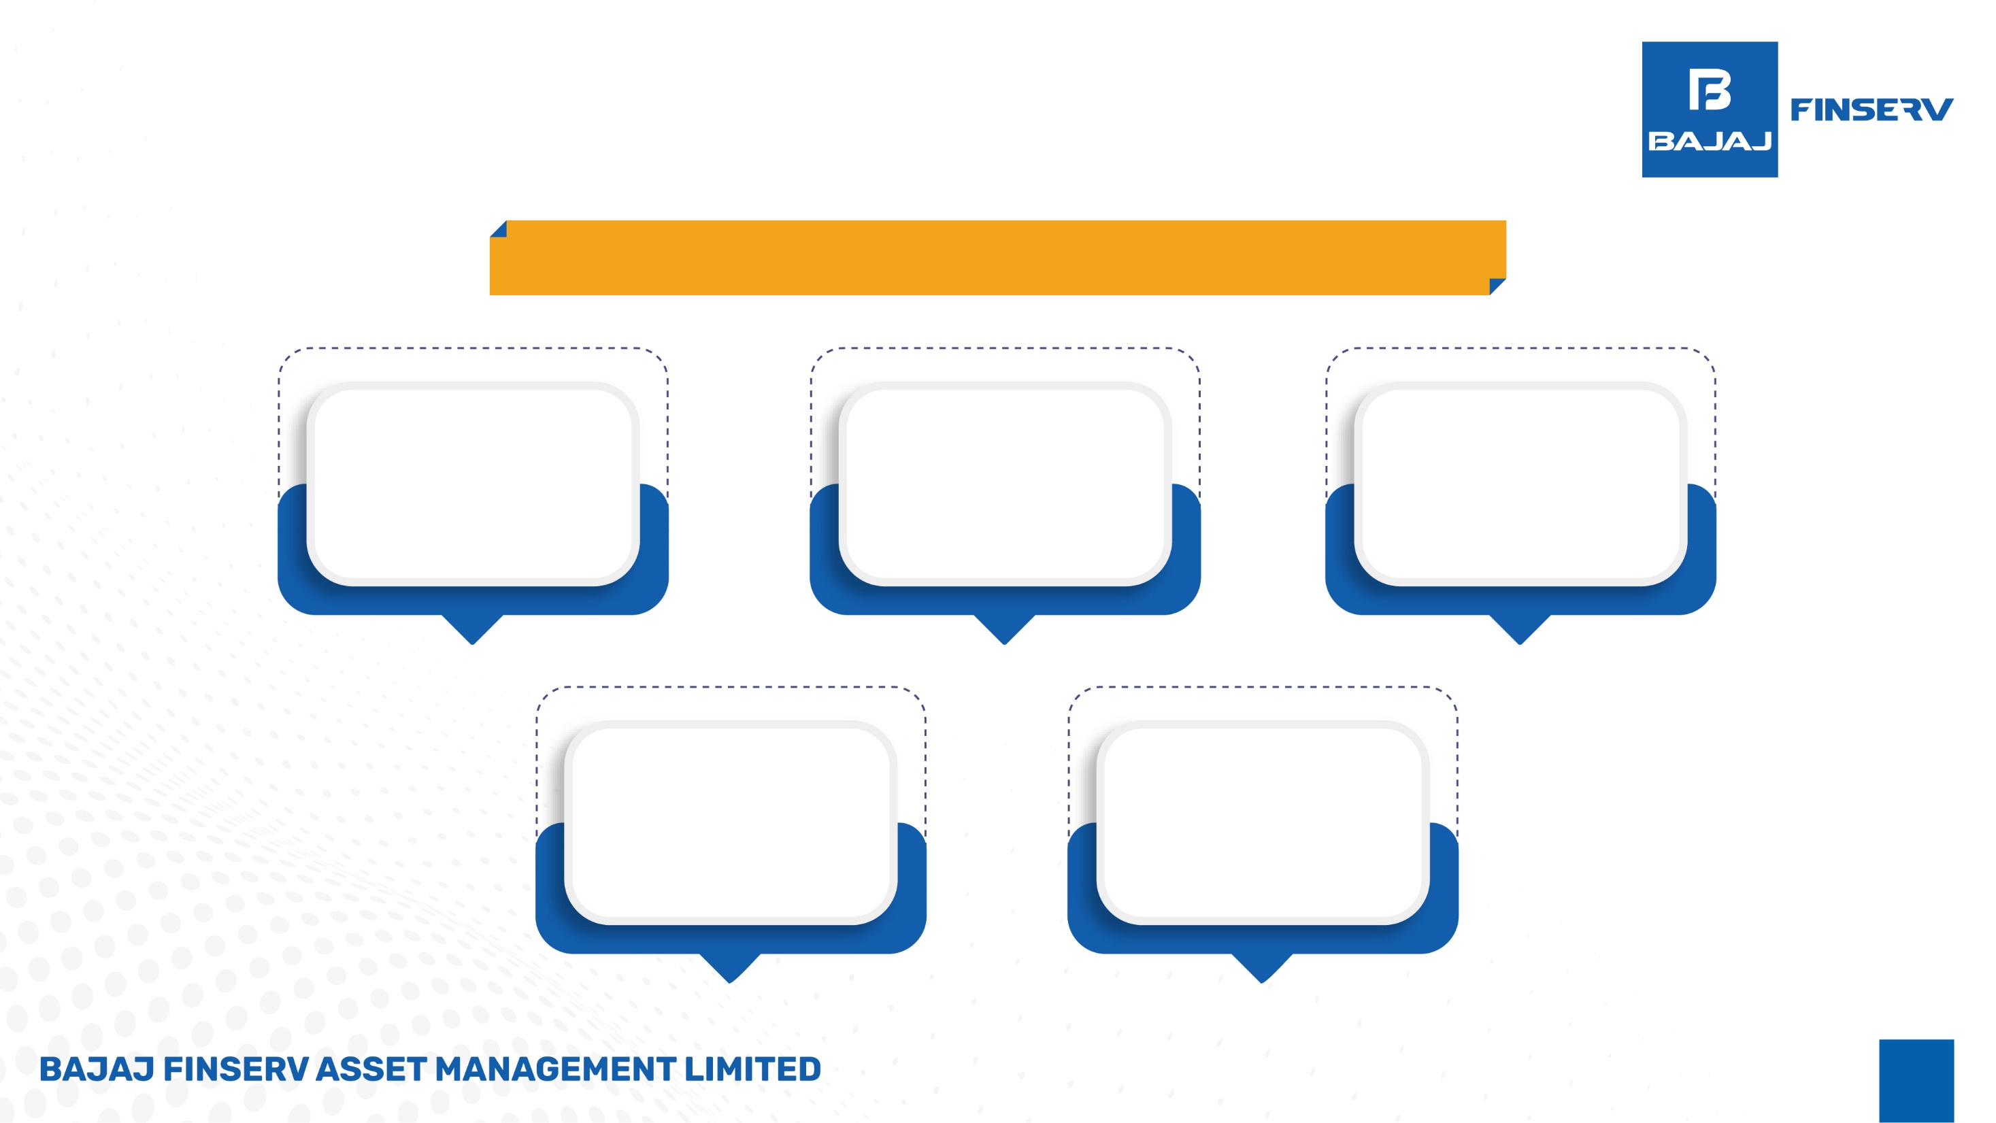
Bajaj Finserv Nifty Bank ETF Features
Market Maker
East India Securities Ltd.
Kanjalochana Finserv Pvt. Ltd.
Parwati Capital Market Pvt. Ltd.
Benchmark
NIFTY Bank TRI
Loads
Entry load – not applicable
Exit load – Nil
Listing
NSE & BSE
ETF Units
Creation Unit Size = 50,000 units

Slide 11
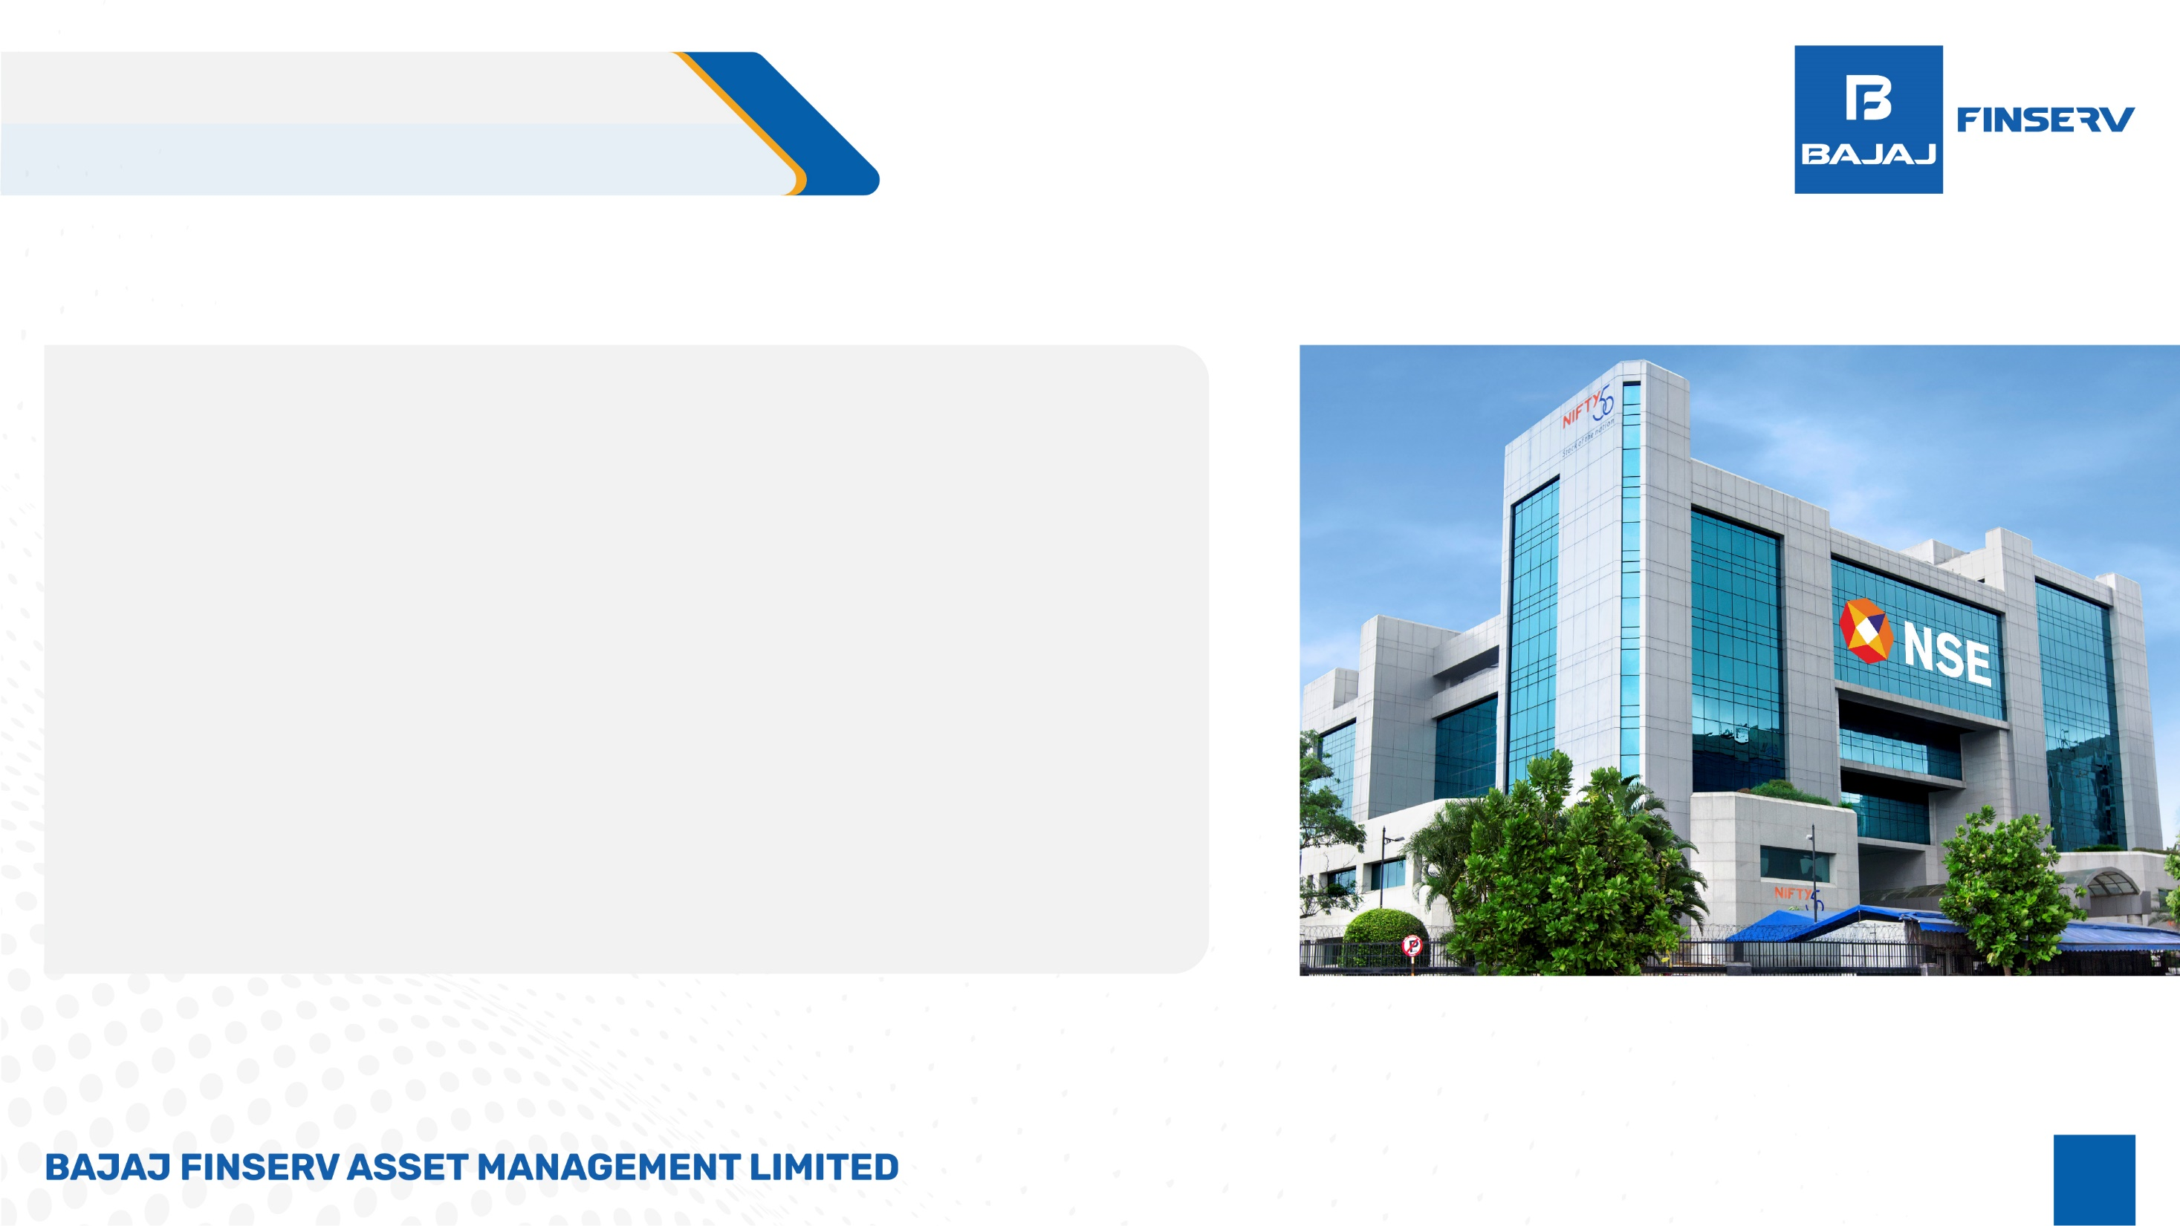
About Nifty Bank index
Nifty Bank Index is comprised of the most liquid and large capitalised Indian Banking stocks. It provides investors and market intermediaries with a benchmark that captures the capital market performance of Indian Banks.
The Index comprises of maximum 12 companies listed on National Stock Exchange of India (NSE).
Nifty Bank Index is computed using free float market capitalization method.
Nifty Bank Index can be used for a variety of purposes such as benchmarking fund portfolios, launching of index funds, ETFs, and structured products.
Index Variant: Nifty Bank Total Returns Index.
Source: NSE & Internal Research

Slide 12
Composition of Nifty Bank ETF
Top Company’s Name | Weight (%)
HDFC Bank Limited | 19.00%
ICICI Bank Limited | 14.10%
Axis Bank Limited | 10.00%
State Bank of India | 9.94%
Kotak Mahindra Bank Limited | 9.73%
The Federal Bank Limited | 6.18%
IndusInd Bank Limited | 4.80%
AU Small Finance Bank Limited | 4.49%
Bank of Baroda | 4.44%
Canara Bank | 4.05%
As on 31st March 2026

Slide 13

Nifty Bank TRI Performance through years
Source: ICRA MFI As on 1st Jan 2026
Disclaimer: Past performance is no guarantee of future results.

Slide 14
Fund Facts
Scheme name | Bajaj Finserv Nifty Bank ETF
Scheme Category | Exchange Traded Fund
Scheme Type | An open ended exchange traded fund tracking Nifty Bank Index
Scheme Riskometer | Very High Risk
Benchmark | Nifty Bank TRI
Fund Manager | Mr. Ilesh Savla
Investment Objective | The investment objective of the Scheme is to provide returns that are corresponding with the performance of the Nifty Bank Index, subject to tracking errors However, there can be no assurance or guarantee that the investment objective of the Scheme would be achieved.
Listing | NSE BSE
NAV in Rs. | 50.8900
AUM in Rs. Cr. | 354.95
Tracking Error (%) Tracking Difference (%) | 0.05 -0.22
TER (%) | 0.13
14
Data as on 31st March 2026

Slide 15
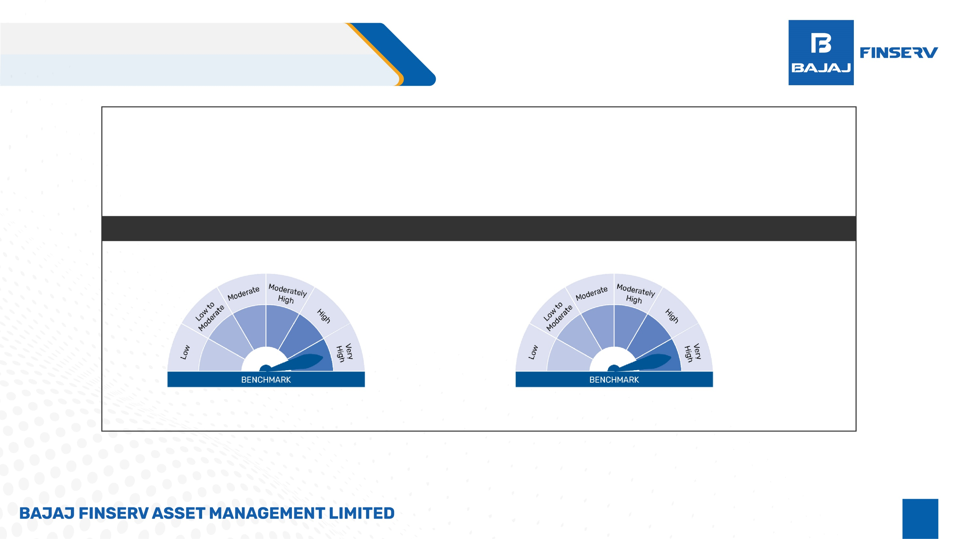
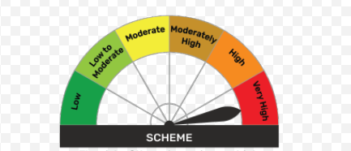
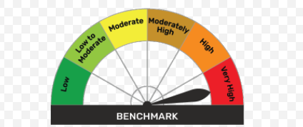
Product Label and Riskometer
This product is suitable for investors who are seeking*:
Wealth creation over long term
An exchange traded fund that seeks to provide returns that correspond to the returns provided by Nifty Bank Index, subject to tracking error
*Investors should consult their financial advisers if in doubt about whether the product is suitable for them
Scheme
Benchmark
SCHEME
Investors understand that their principle will be at very high risk
Nifty Bank TRI

Slide 16


Disclaimer of AMC
This document should not be treated as endorsement of the views/opinions or as an investment advice. This document should not be construed as a research report or a recommendation to buy or sell any security. This document alone is not sufficient and should not be used for the development or implementation of an investment strategy. The recipient should note and understand that the information provided above may not contain all the material aspects relevant for making an investment decision. The decision of the Investment Manager may not always be profitable; as such decisions are based on the prevailing market conditions and the understanding of the Investment Manager. Actual market movements may vary from the anticipated trends. Neither Bajaj Finserv Mutual Fund / Bajaj Finserv Mutual Fund Trustee Limited / Bajaj Finserv Asset Management Limited nor its Directors or employees shall be liable for any damages whether direct or indirect, incidental, punitive special or consequential including lost revenue or lost profits that may arise from or in connection with the use of the information. Investors are advised to consult their own investment advisor before making any investment decision in light of their risk appetite, investment goals and horizon. This information is subject to change without any prior notice.
This product is suitable for investors who are seeking*:
Wealth creation over long term
An exchange traded fund that seeks to provide returns that correspond to the returns provided by Nifty Bank Index, subject to tracking error
*Investors should consult their financial advisers if in doubt about whether the product is suitable for them
Disclaimer of NSE
Scheme
Benchmark
It is to be distinctly understood that the permission given by NSE should not in any way be deemed or construed that the Scheme Information Document has been cleared or approved by NSE nor does it certify the correctness or completeness of any of the contents of the Draft Scheme Information Document. The investors are advised to refer to the Scheme Information Document for the full text of the 'Disclaimer Clause of NSE.
Disclaimer of BSE
SCHEME
It is to be distinctly understood that the permission given by BSE limited should not in any way be deemed or construed that the SID has been cleared or approved by BSE limited nor does it certify the correctness or completeness of any of the contents of the SID. The investors are advised to refer to the SID for the full text of the Disclaimer clause of the BSE limited.
Investors understand that their principle will be at very high risk
Nifty Bank TRI
#The product labelling assigned during the New Fund Offer is based on internal assessment of the Scheme Characteristics or model portfolio and the same may vary post NFO when actual investments are made.
Mutual Fund investments are subject to market risks, read all scheme related documents carefully.

